Slide 1
Car parking management system

Slide 2

ABSTRACT:
Advanced online parking system is a project developed to provide an easy way in finding the parking space for vehicles.
This project helps users by analyzing the areas where parking is available and details about number of slots free in that area.
Advanced online parking system enables users to book before four hours prior to his expected arrival, the user can pre-book a slot in the area he desires if it is available.
This will help reduce the load on the administrator as his physical work reduces drastically and user can search the parking slot easily.

Slide 3
introduction
Nowadays parking has become an expensive resource in almost all majorities in the world, and its limited availability is the concurrent cause of urban traffic congestion and air pollution.
The user requests the Parking Control Unit to check the status of available parking slots.
The main responsibility of the car parking management system is to help the user to find an area where parking is available and total number of slots free in that area.

Slide 4
EXISTING
In the existing system the number of personal vehicles usage is increasing manifold.
Finding a parking space in most metropolitan areas, especially during the rush hours, is difficult for drivers.
No service provider are available, shopping mall and customer need to work as a unit to make the parking which takes a lot of time in searching for a parking slot.
It includes the man power and expensive devices that results in high cost for maintenance.

Slide 5
SOFTWARE REQUIRMENTS
Operating system : Microsoft Windows 11,64bit (operating system).
Front End : Microsoft visual studio 2010 professional, 64 bit
Back End : SQL Server
HARDWARE REQUIREMENTS:
System : Windows 11
Speed : 2.42 GHz
Hard Disk : 500GB
RAM : 16GB

Slide 6
MODULE
USER MODULE:
The user module allows users to register, log in, and log out. Users benefit from being able to sign on because this associates content they create with their account and allows various permissions to be set for their roles.The user module supports user roles, which can be set up with fine-grained permissions allowing each role to do only what the administrator permits. Each user is assigned one or more roles.

Slide 7
BOOKING MODULE:
This booking module is about parking your car in the available slot. This reservation system increases your online booking rates.Set your own booking rules, automate the reservation process, and provide your customers with an easy and reliable online service.

Slide 8
ADMINISTRATOR MODULE :
This is the operative module of the application. It works in the backend for managing the database and performs various operations on it.
The administrator stores all the user’s data in the database as soon as he gets registered with the application. Administrator maintains the details of all parking slots ( both empty and reserved), their price for booking , user details in database and the modification on these data is only can be done by the administrator.

Slide 9
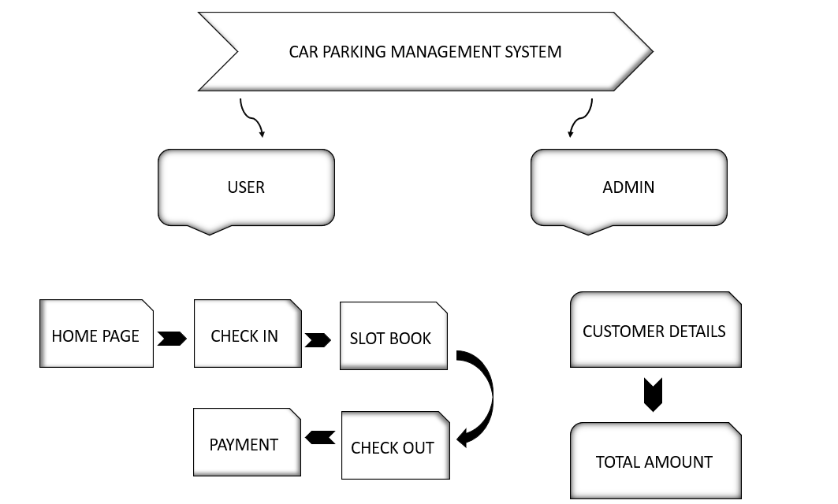
Overall System Design Structure

Slide 11
CONCLUSION
Our project successfully reduces the parking problem in places of entertainment such as theatres and shopping malls. Our project helps in finding out the availability of a parking slot , get the availability confirmed, and reach the place within the time slot allotted. It helps the administration to allocate the vacant slot to the next person in queue. Our project saves the time of visitors in booking a parking slot.

